Slide 2
By the end of the lesson, you will be able to:
LESSON OBJECTIVES
1
Determine what to do when you find an unattended firearm.
2
Explain firearm safety information and tell it to your peers.
3
Identify when you should report a threat against the school or another student.
Notes:
Introduce the students to the lesson. Discuss what the students will be learning.

Slide 3
WHY IS IT IMPORTANT TO LEARN HOW TO STOP ACCIDENTAL SHOOTINGS?
INTRODUCTION
Notes:
Discuss briefly the importance of learning how to stop accidental shootings. Provide one or two consequences of accidental shootings.

Slide 4
ACCIDENTAL DISCARGE
WHAT IS IT?
It is also known as AD
It occurs when the firearm is fired UNINTENTIONALLY
Notes:
Introduce the students to the term “accidental discharge.”
An accidental discharge (AD) of a firearm occurs when the firearm is fired unintentionally, or not on purpose.

Slide 5
ACCIDENTAL DISCHARGE:
CAUSES
HORSEPLAY
IS NEVER TOLERATED.
What can cause an AD?
Wrongly believing a firearm is unloaded
Not properly handling a firearm
Taking part in horseplay with a firearm
Notes:
An AD can be the result of the students believing a loaded firearm is not loaded. It can occur when firearms are mishandled or during horseplay (rough play). Horseplay is never tolerated.

Slide 6
ACCIDENTAL DISCHARGE:
PREVENTION
Q. HOW CAN YOU PREVENT AN AD?
A. TREAT EVERY FIREARM AS IF IT WERE LOADED.
Notes:
The students can prevent an AD by adopting the attitude that firearms are always loaded. This attitude can prevent the students from experiencing an AD and from ever having to say, “I didn’t think the gun was loaded.”

Slide 7
L.E.T.S.
STAY
SAFE
Leave it alone.
Educate those around you.
Tell an adult.
Share threats against the school or students with authorities.
Notes:
Introduce the students to the mnemonic device “L.E.T.S. stay safe” that will help them remember the firearm safety guidelines:
Leave it alone. Do not touch unattended firearms or put your finger on the trigger.
Educate those around you. Share safety guidelines with peers who are with you when you find the firearm.
Tell an adult. Immediately tell a responsible adult (parent, teacher, or school resource officer) about finding a firearm and its location.
Share threats against the school or students with authorities. Tell a teacher, counselor, school resource officer, or another adult of threats against the school or students.

Slide 8
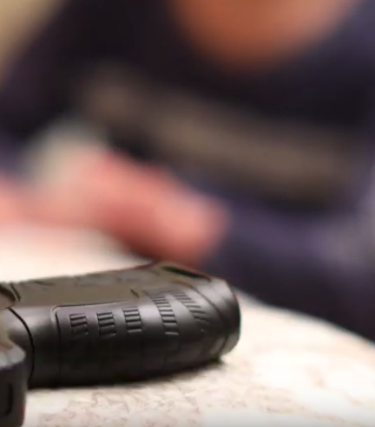
Watch the video:
https://youtu.be/VElXt5e3uiM
Notes:
Show the L.E.T.S. Stay Safe firearm safety video. Discuss how the children in each scenario followed the L.E.T.S. Stay Safe guidelines.

Slide 9
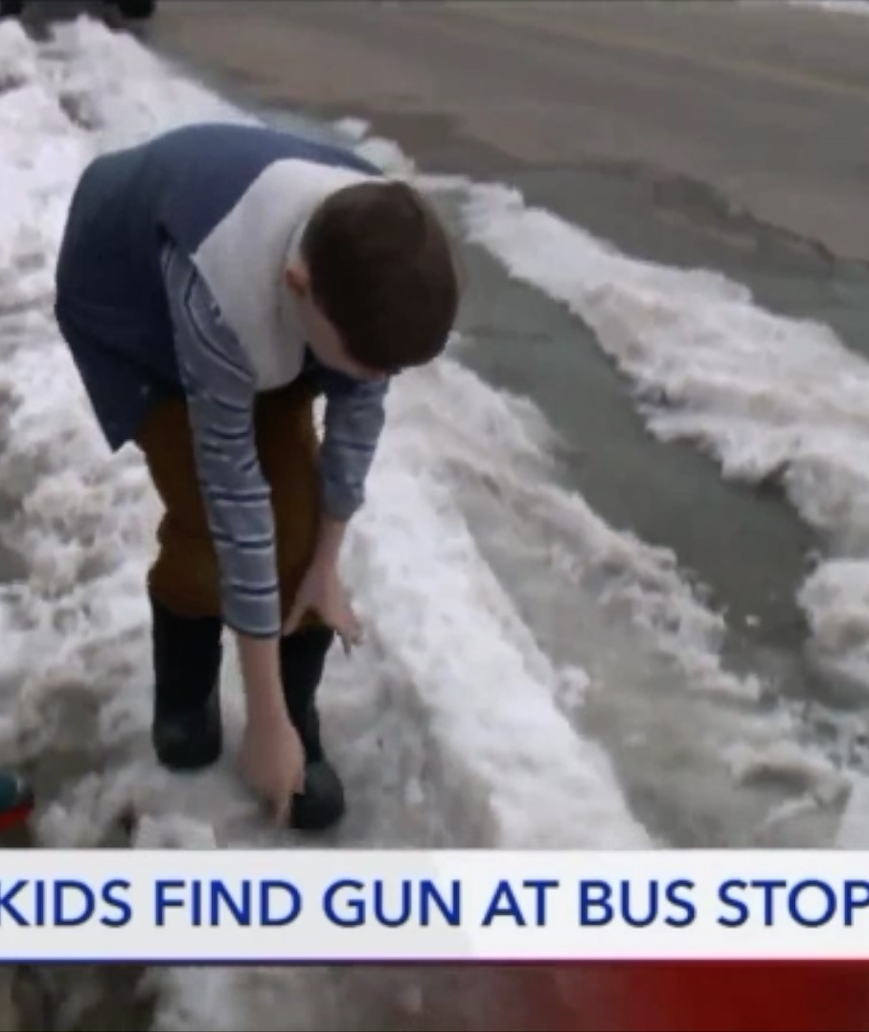
UNATTENDED FIREARM AT THE BUS STOP
Notes:
Discuss the news story of the nine-year-old boys who found a gun buried in the snow while waiting for their school bus in Pleasant Grove, Utah.

Slide 10

UNEXPECTED LOCATIONS:
HOME
Notes:
Identify the locations in the home or in a friend’s house where firearms can be unexpectedly found during play or other activities:
In a drawer
Under a bed
Hidden in furniture, a tool box, a garage, or an outbuilding

Slide 11
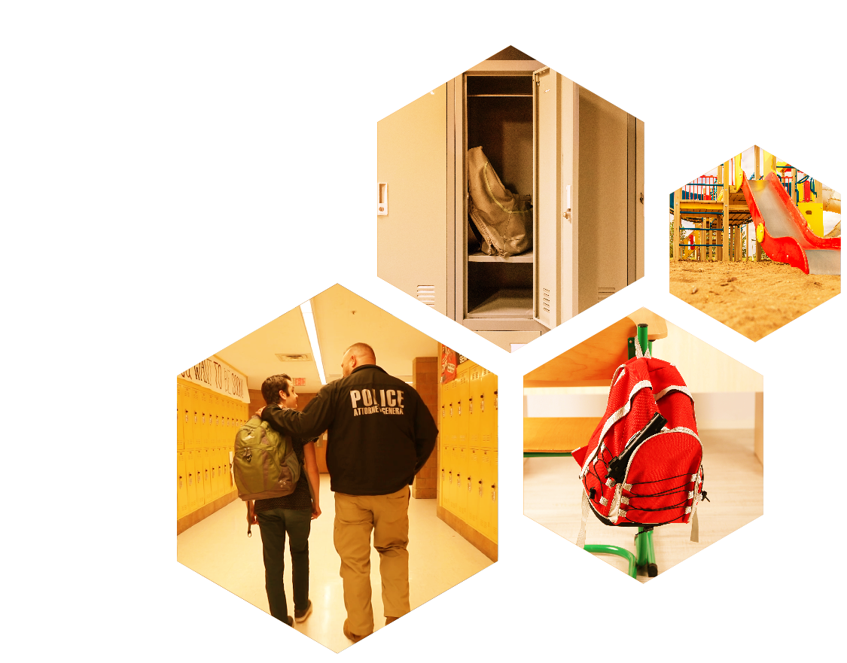
UNEXPECTED LOCATIONS:
SCHOOL
Notes:
Identify the locations in a school where firearms can be unexpectedly found during play or other activities:
On the playground
In a locker
Inside a backpack

Slide 12

UNEXPECTED LOCATIONS:
PUBLIC BATHROOMS
Notes:
State that public bathrooms is a place where firearms can be unexpectedly found during play or other activities.

Slide 13

UNEXPECTED LOCATIONS:
VEHICLES
Notes:
State that vehicles (e.g., buses, trains, planes, or cars) are places where firearms can be unexpectedly found during play or other activities.

Slide 14
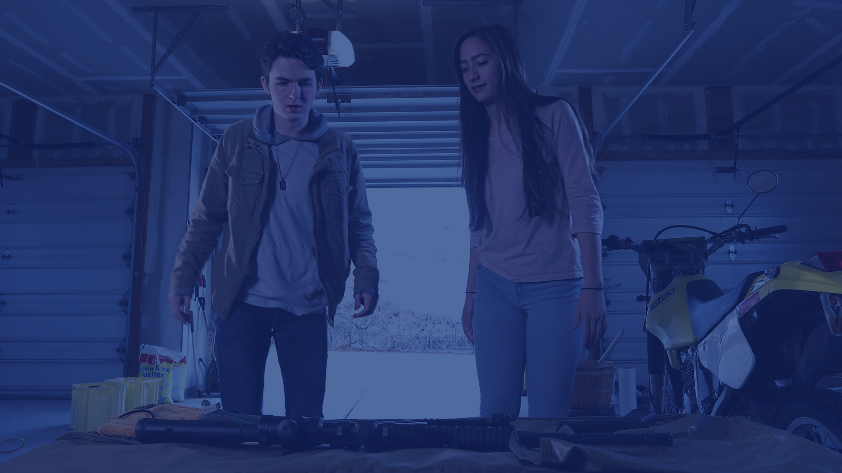
DANGERS OF FINDING AN UNATTENDED FIREARM
What could happen if you found an unattended firearm?
Notes:
List the dangers of discovering an unattended firearm. Include an AD resulting from the following:
Curious examination of firearm
Unknown firearm condition (loaded)
Unknown safety feature (operational or in need of repair)
Unsafe location to point muzzle
Unsafe people present who are untrained, careless, or negligent
Not recognizing that real firearms are different from the ones that students see on TV or in video games

Slide 15
ACT IT OUT
Remember “L.E.T.S. stay safe.”
Notes:
Provide role-play scenarios in which student volunteers encounter an unattended firearm (the dummy training firearm). Here are examples of scenarios:
Scenario 1: A student finds an unattended firearm while searching for a lost phone. The firearm is located in a vehicle under the front seat on the driver’s side. A younger sibling is with the student. The student’s parents are in the house.
Scenario 2: A student finds an unattended firearm while playing a league game. The firearm is located on the edge of a soccer field. Two teammates are with the student. The student’s coach and the rest of the team are on the opposite end of the playing field.
Scenario 3: A student receives a text message from a friend that states her boyfriend has a gun in his backpack.
After each scenario, ask the class if the students in the scenario followed the L.E.T.S. Stay Safe guidelines. Discuss what went well and what improvements could be made.

Slide 16
SUMMARY
WHAT DID YOU LEARN?
Notes:
Review key points that the students should remember from the lesson.
Distribute marketing materials from the L.E.T.S. Stay Safe campaign to the students.

